Slide 1

SOFTWARE ENGINEERING
PROJECT REVIEW
FINAL PRESENTATION

Slide 2
PROJECT TITLE: TRAILBLAZER’S ARENA
TEAM NUMBER: 8
TEAM MEMBERS
MURALI KRISHNAN.P 18BCS001
THANUMALYEN.K 18BCS002
MANJU.S 18BCS007
MRIDULA.C.S 18BCS008
VARSHINI.R 18BCS073

Slide 3
OBJECTIVE
To develop an online platform especially for Computer Science students .
developing ideas and to meet the high demand requirements in the software market.
Active participation in the department association.
Make students strong in their domain.
Knowledge about CSE DA.

Slide 4
INTRODUCTION
The Trailblazer’s arena is an online platform for students with enormous options like,
DIY encouragement.
Project ideas
Improve active participation.
Improve coding and problem solving skills.
Read and write blogs
View art gallery and upload art works.
View weekly news.

Slide 5
PURPOSE
Encourage students to get actively participated in their department
association activities.
Can view DIY projects and real projects.
Can solve problems posted by the CSE Coding community.
To read and write blogs.
To view and upload art works.

Slide 6
EXISTING SYSTEM
Kctcseda.netlify.com
PROS:
A lot of options are available that includes,
About CSE DA
About DA Members
DA Events
Blogs
User Interface is good.
CONS:
Website is slow to load.
No backend functionality.
Not completed yet.

Slide 7
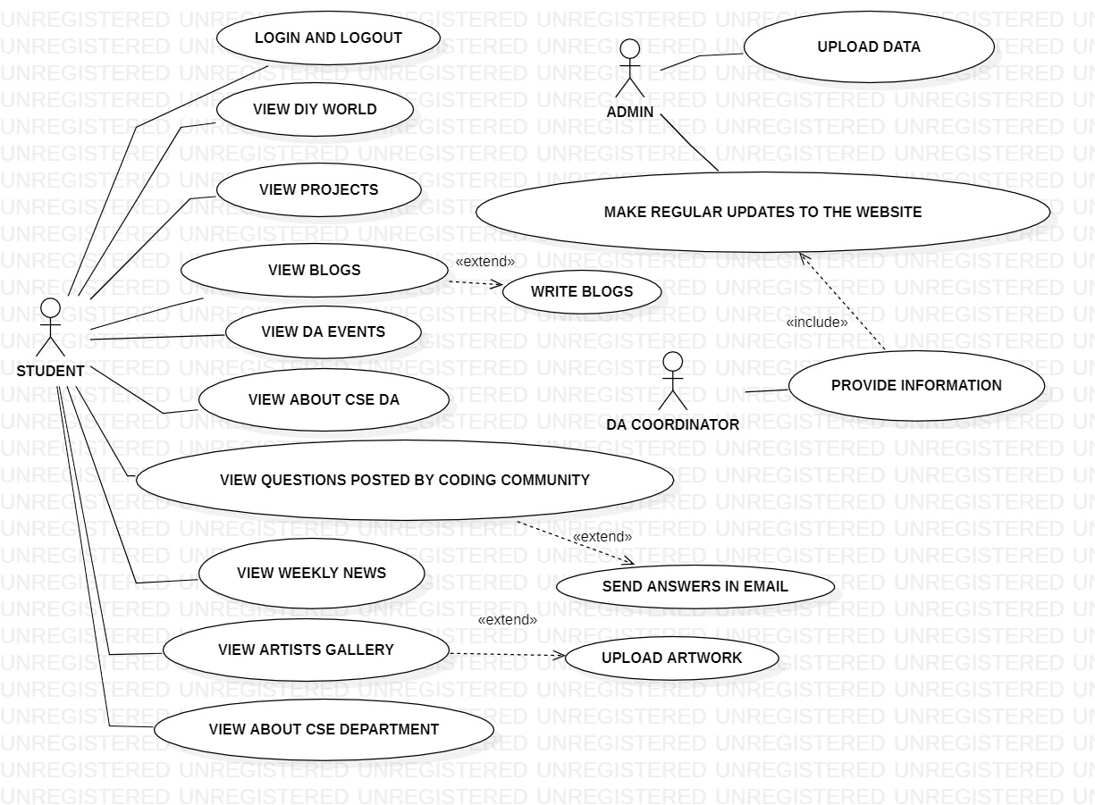
USE CASE DIAGRAM

Slide 8
MODULES INVOLVED
MODULE 1: Login page
DESCRIPTION: This module allows students to login or register to the website. Details are updated in the database. Whenever student logins to the system the details are checked in the database and directs to home page.
MODULE 2: Home page
DESCRIPTION: Home page has the access to all the other modules in the website .It has various options to enter like comments section ,about us section and logout option.It includes the other available modules within the page.

Slide 9
MODULES INVOLVED
MODULE 3: About us
DESCRIPTION: This section provides information about the website developers and objectives.
MODULE 4: Comments
DESCRIPTION: This section provides the student the ability to comment on the website about any queries or issues.

Slide 10
MODULES INVOLVED
MODULE 5: DIY World
DESCRIPTION: This module contains the writeups available for various DIY crafts that students can try .
MODULE 6: Projects
DESCRIPTION: Here students can find projects on various fields and learn more and build their own projects. This also helps students in doing their projects for Engineering clinics.This also shows projects done by students.

Slide 11
MODULES INVOLVED
MODULE 7: Blogs
DESCRIPTION: Students can view and write blogs of their interests and profession.
MODULE 8: CSE DA
DESCRIPTION: This page shows the details of CSE DA and members of DA.

Slide 12
MODULES INVOLVED
MODULE 9: Events
DESCRIPTION: Students can view about the events conducted by the CSE DA.
MODULE 10: CSE Coding community
DESCRIPTION: This page shows the details of many problem statements for students to solve.

Slide 13
MODULES INVOLVED
MODULE 11: Artists gallery
DESCRIPTION: Students can upload their art works and view art works.
MODULE 12: Weekly updates
DESCRIPTION: Weekly news on students achievement are displayed here.
MODULE 13: CSE page
DESCRIPTION: Students can view about CSE Department.

Slide 14
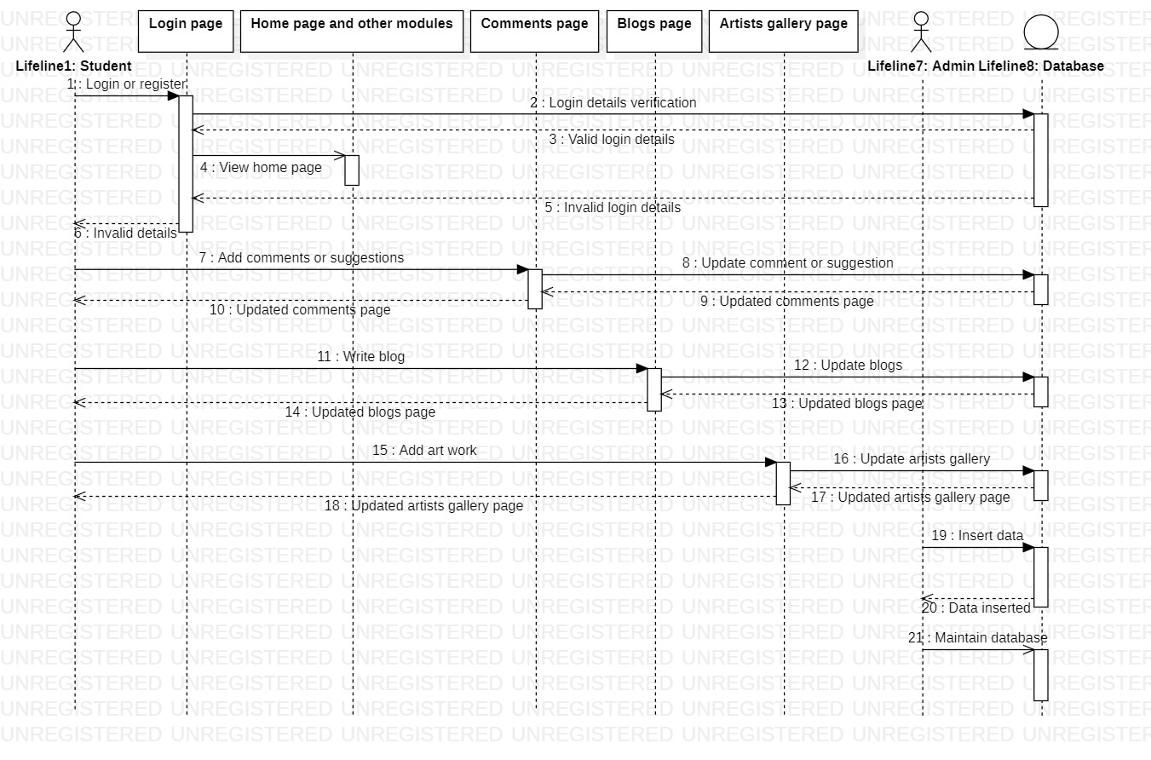
SEQUENCE DIAGRAM

Slide 15
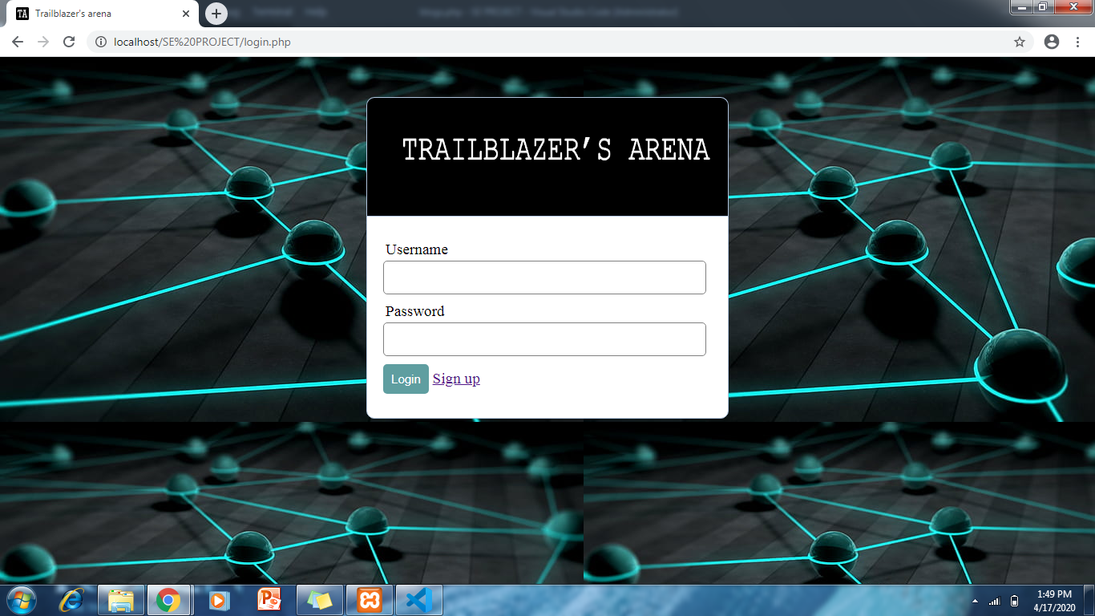
SCREENSHOTS
Login page

Slide 16
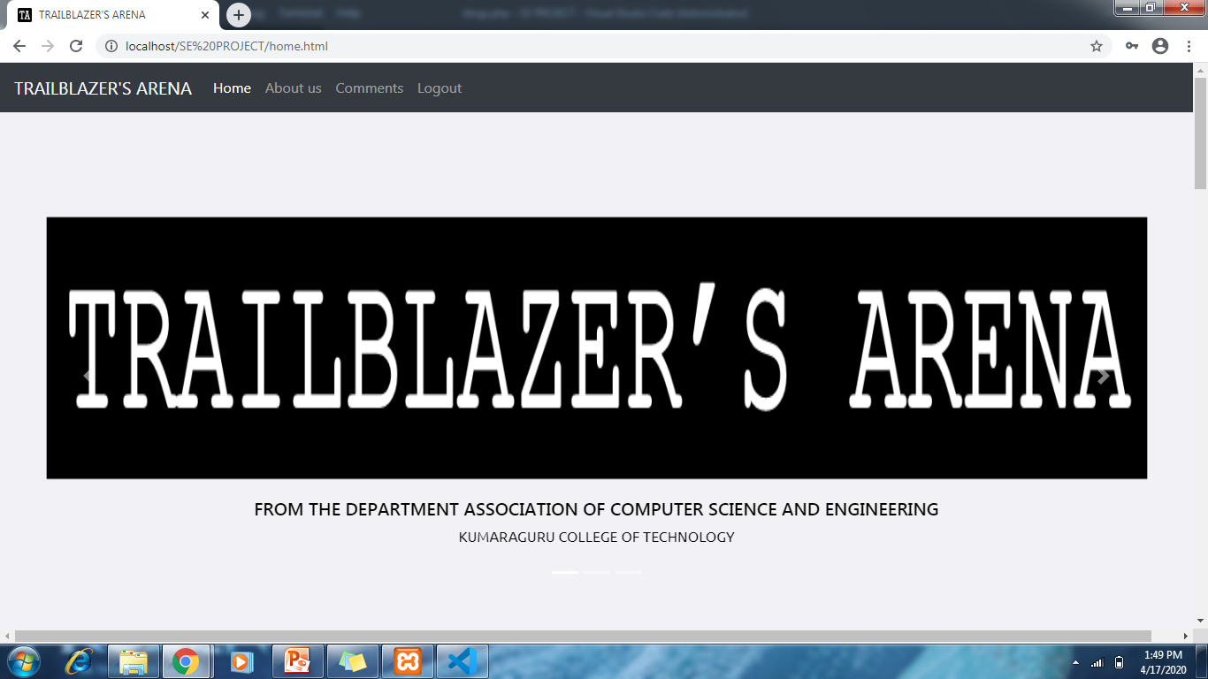
Home page

Slide 17
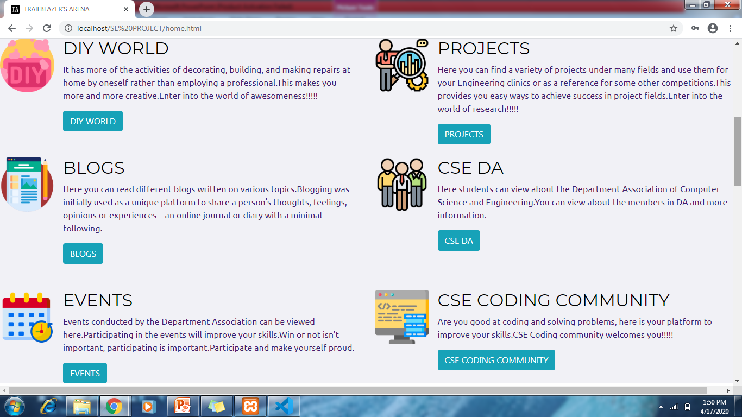
Home page

Slide 18
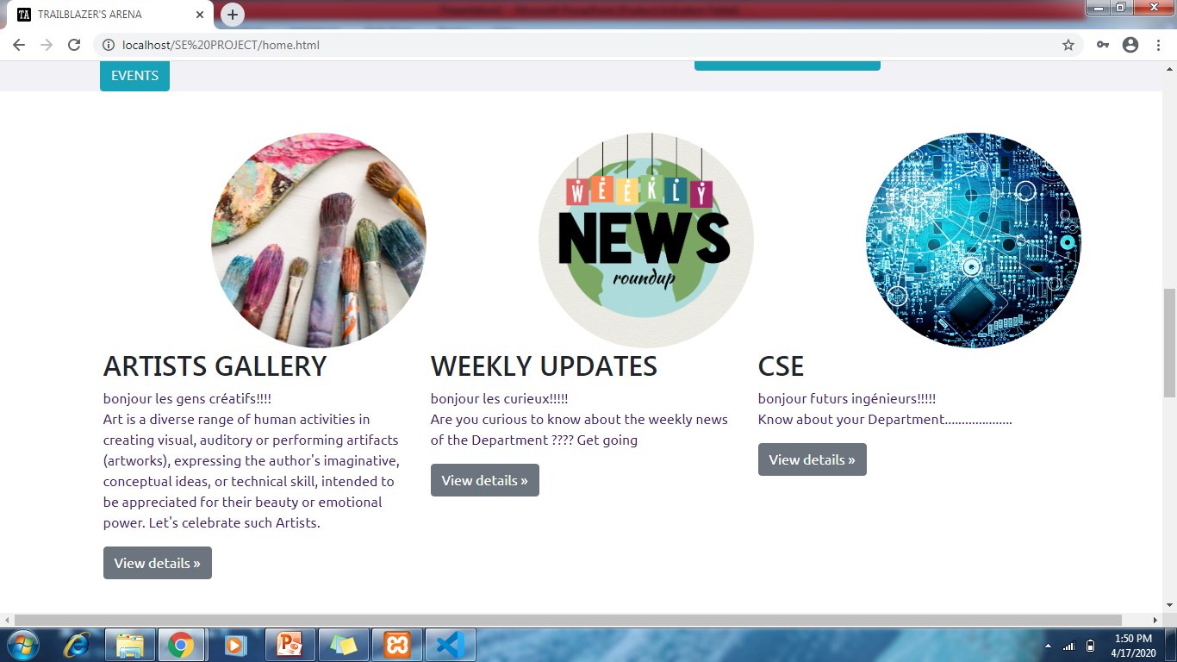
Home page

Slide 19
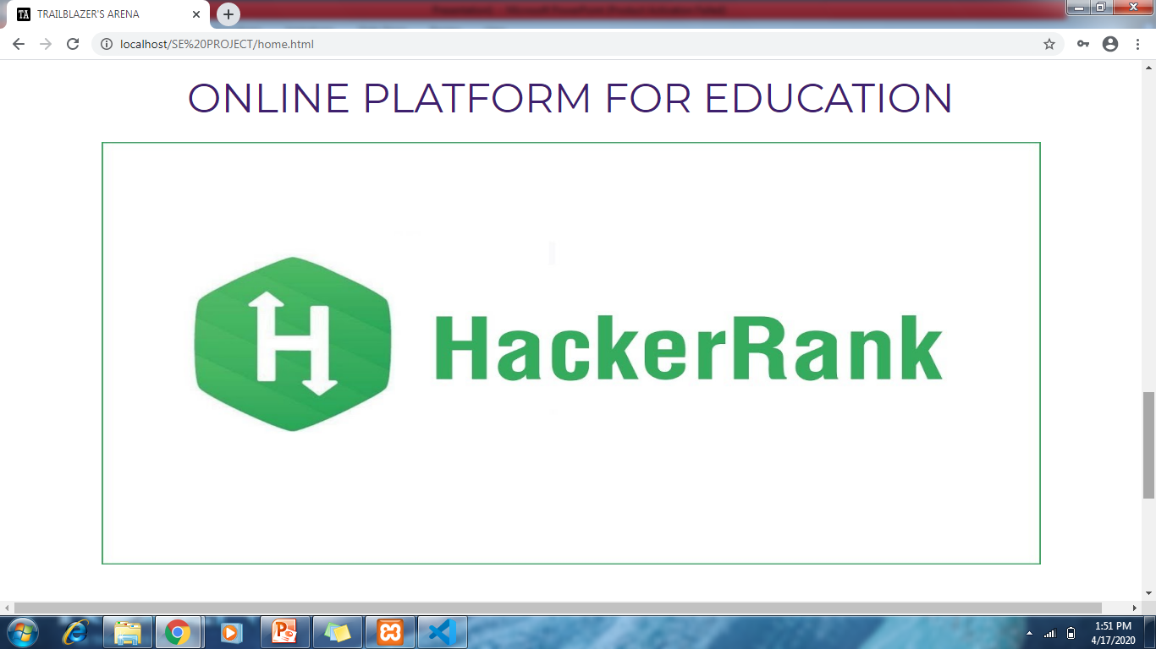
Home page

Slide 20
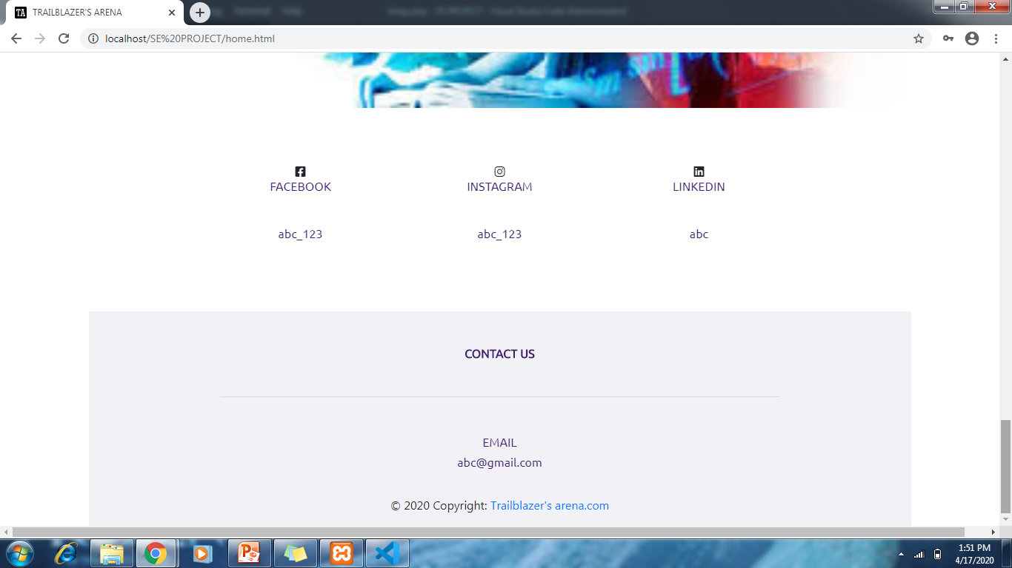
Home page

Slide 21
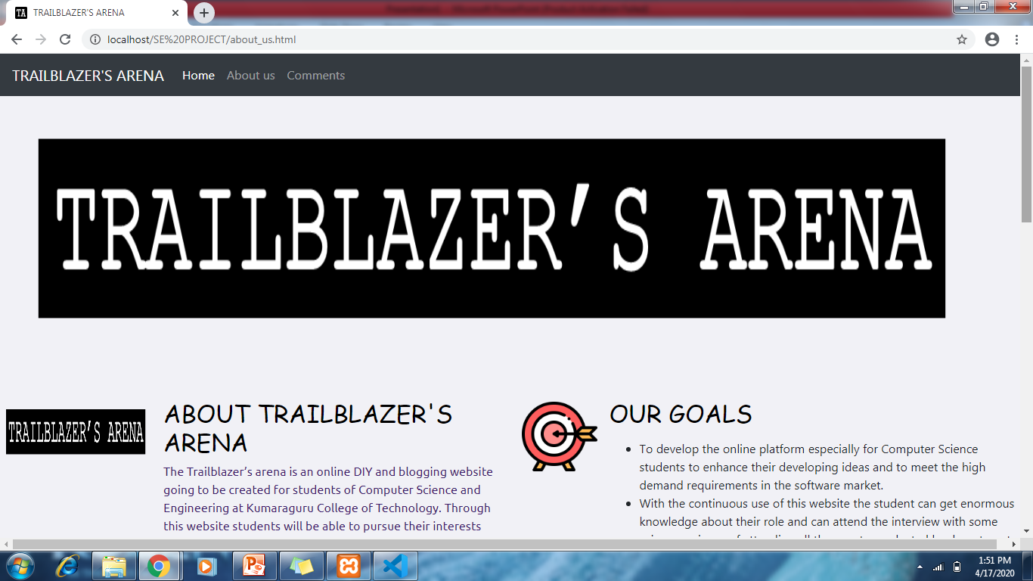
About us page

Slide 22
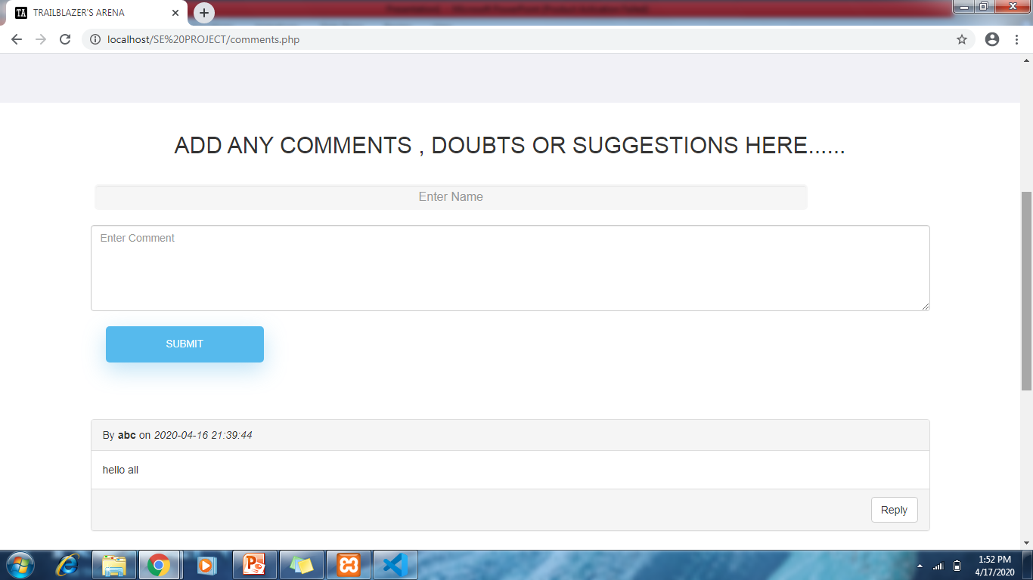
Comments page

Slide 23
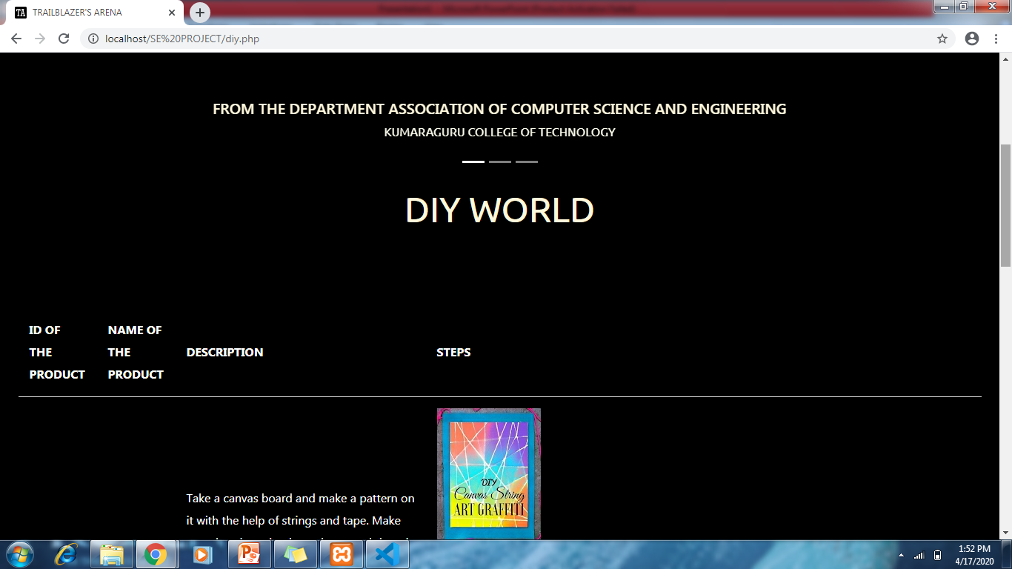
DIY World page

Slide 24
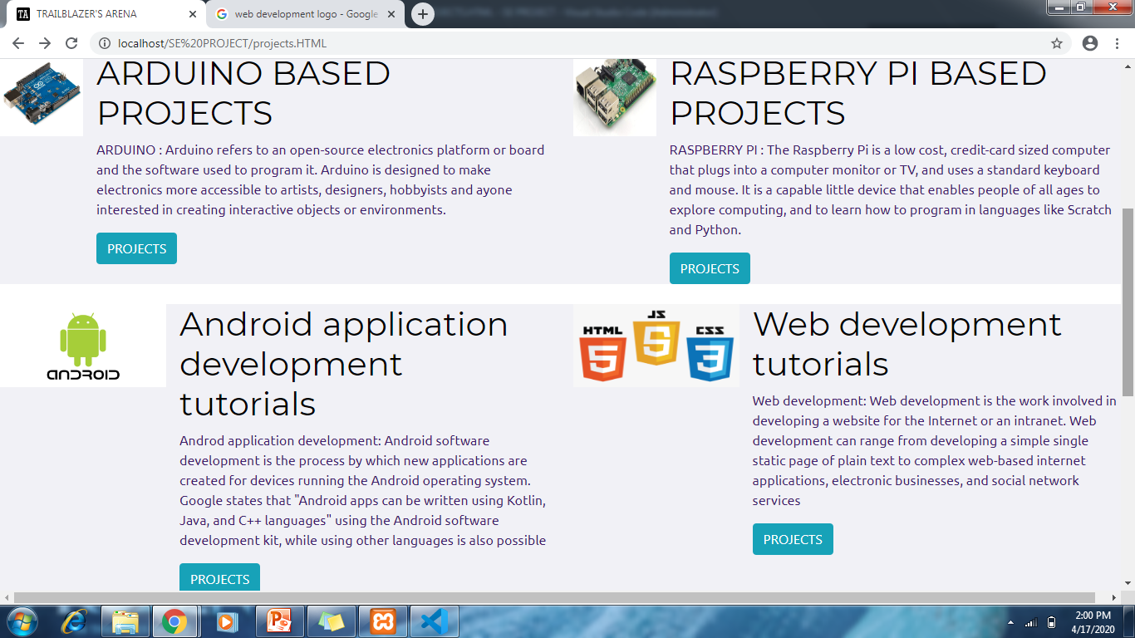
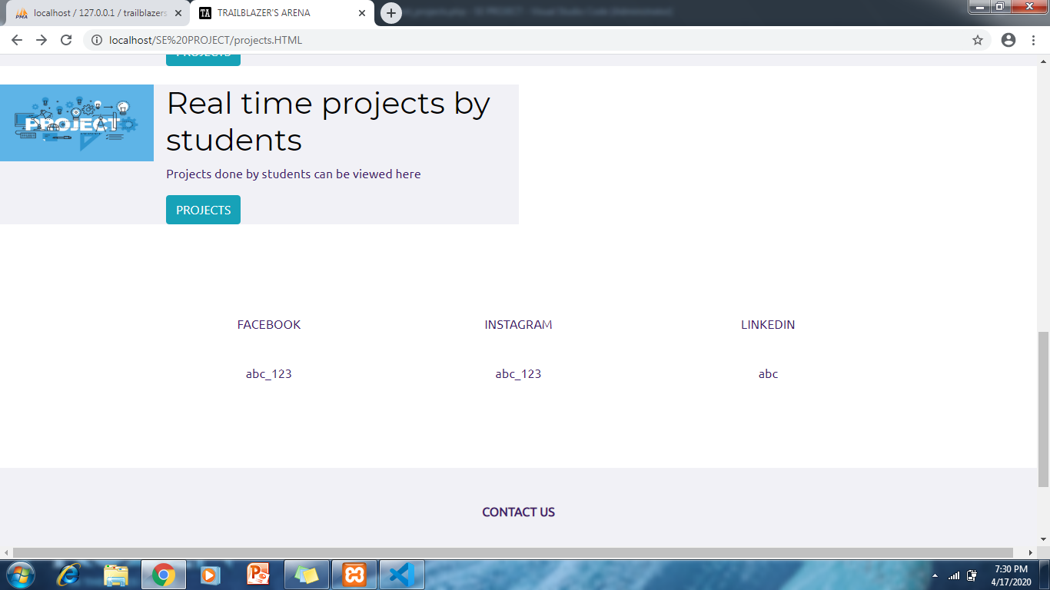
Projects page

Slide 25
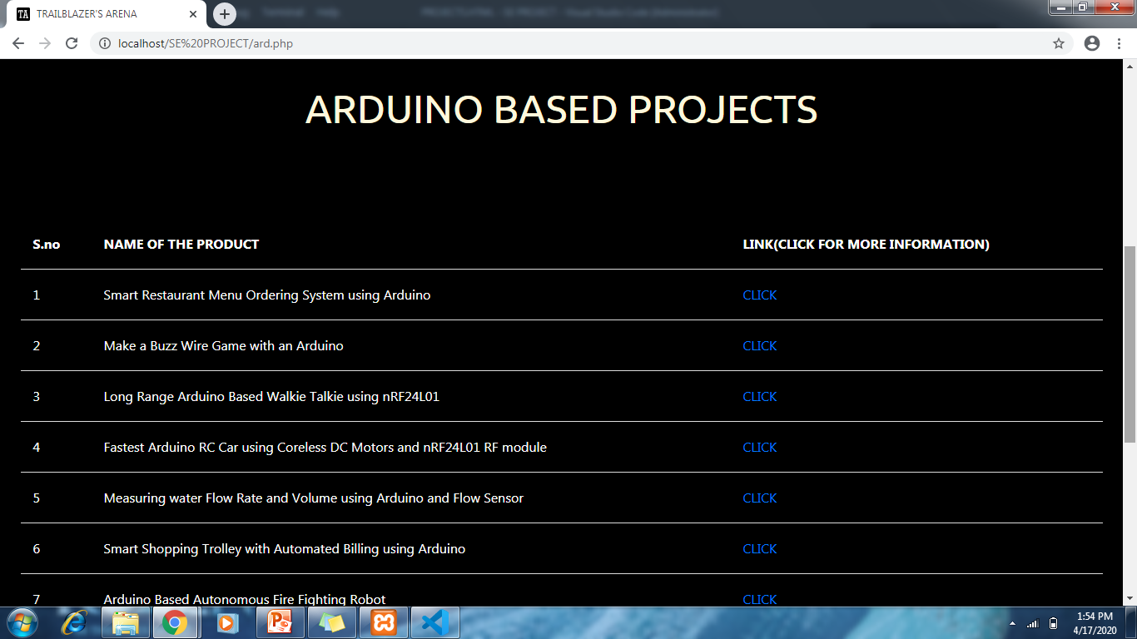
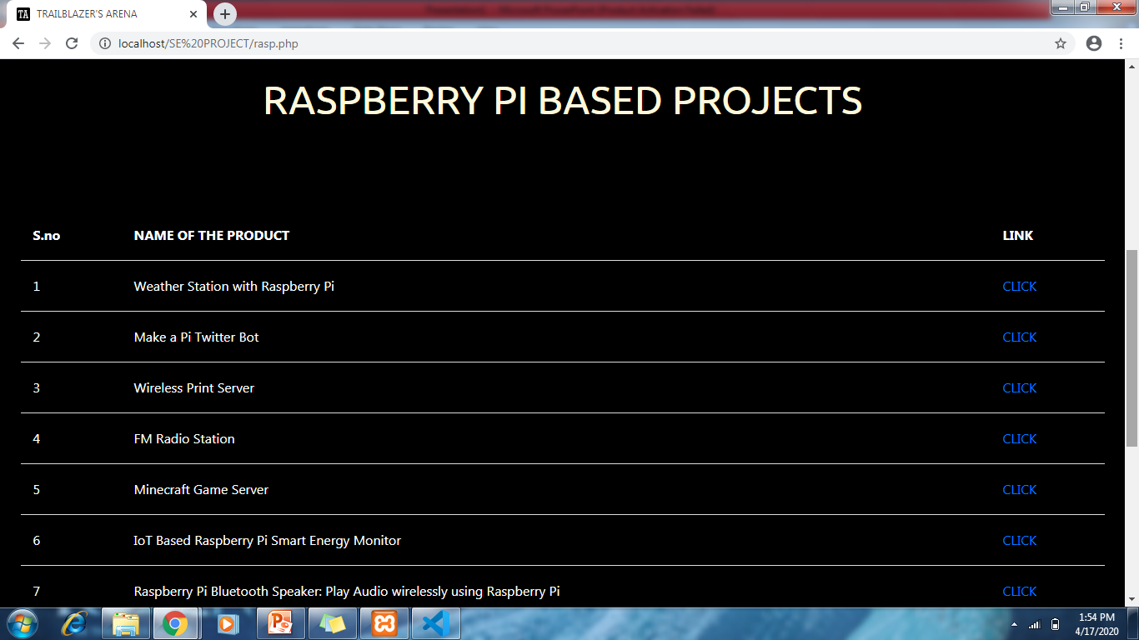
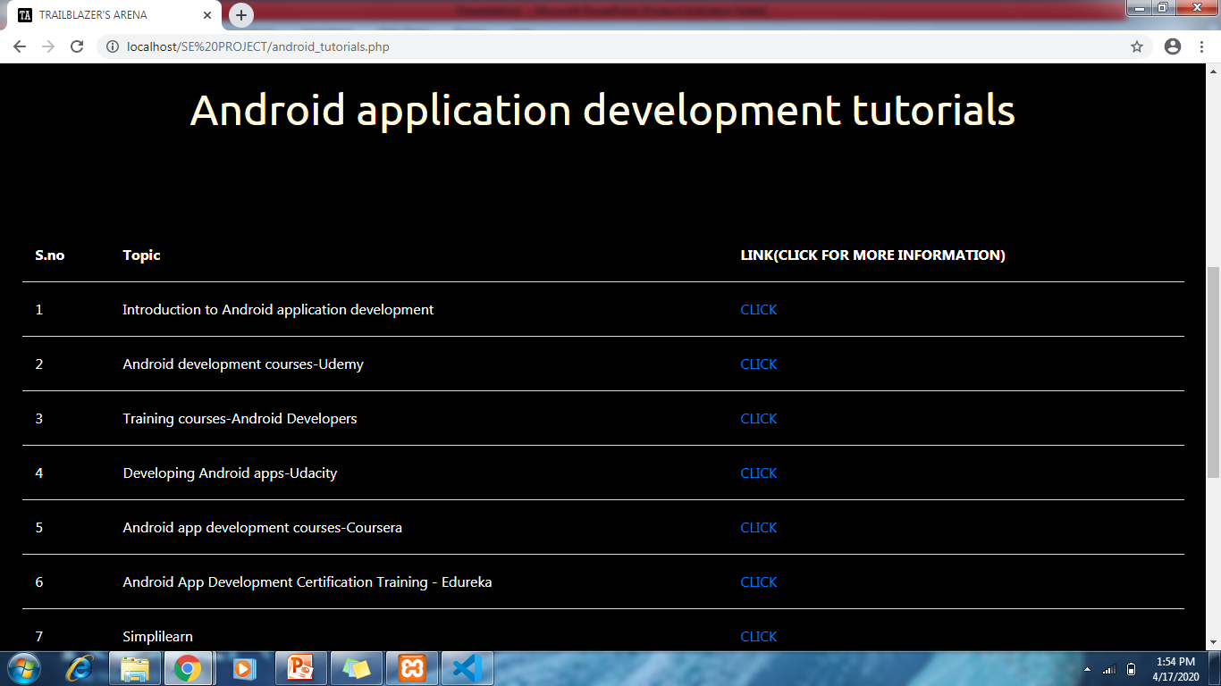
Projects page

Slide 26
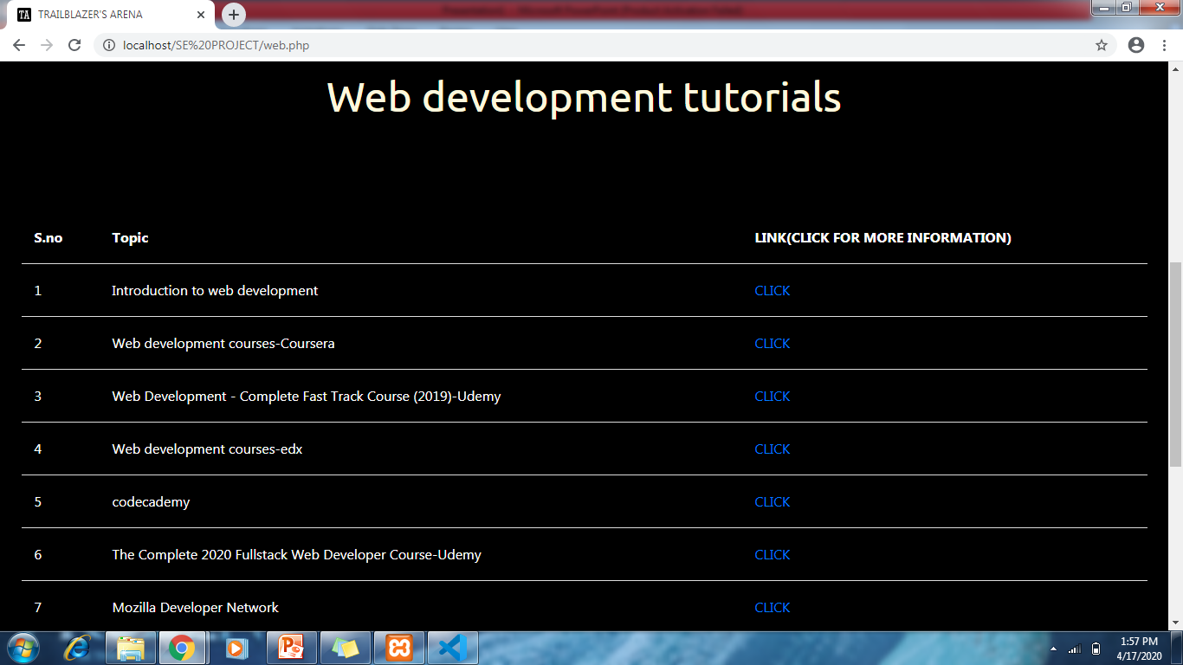
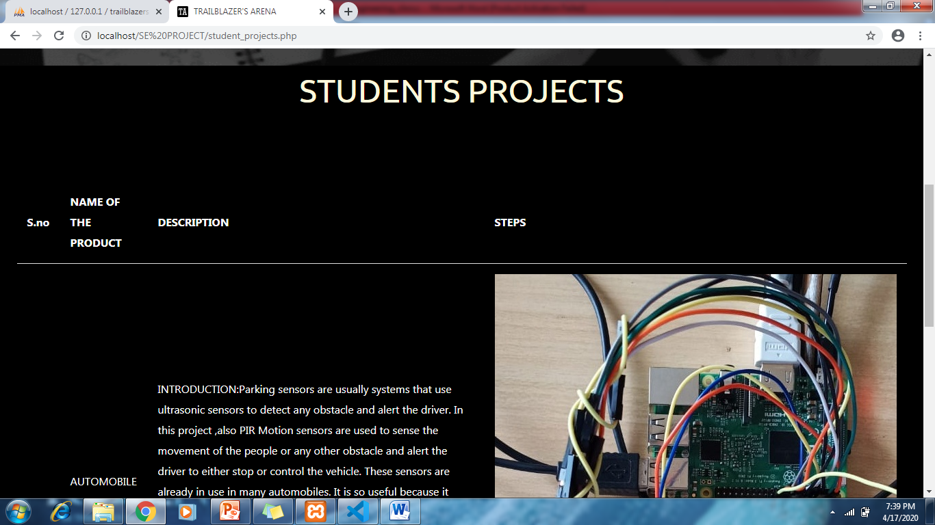
Projects page

Slide 27
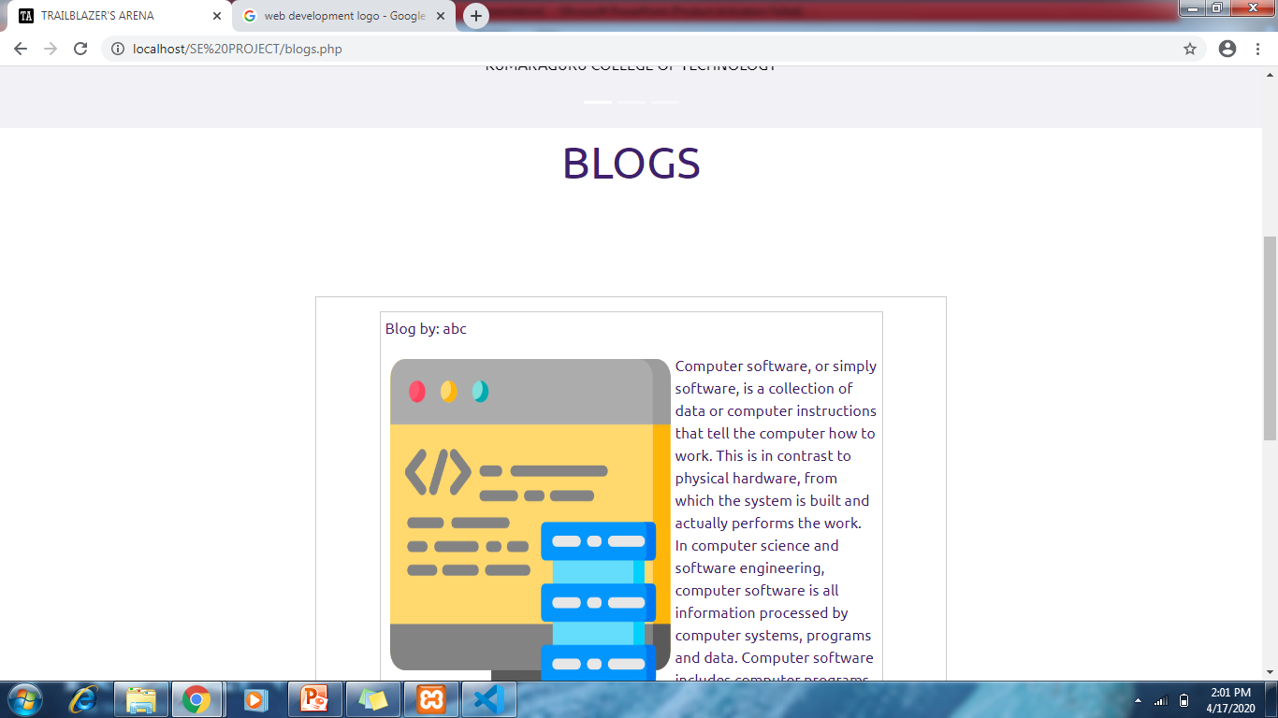
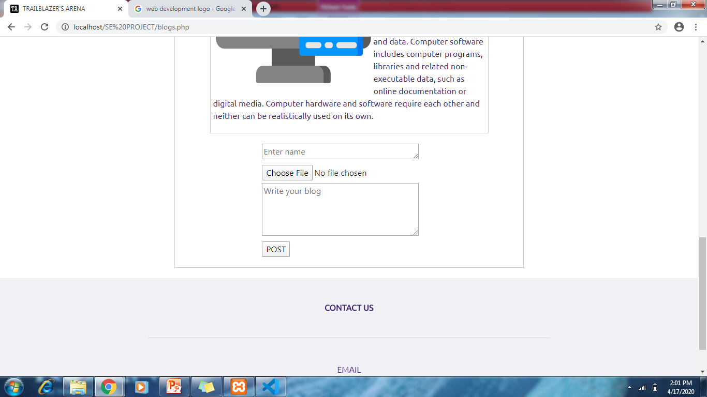
Blogs page

Slide 28
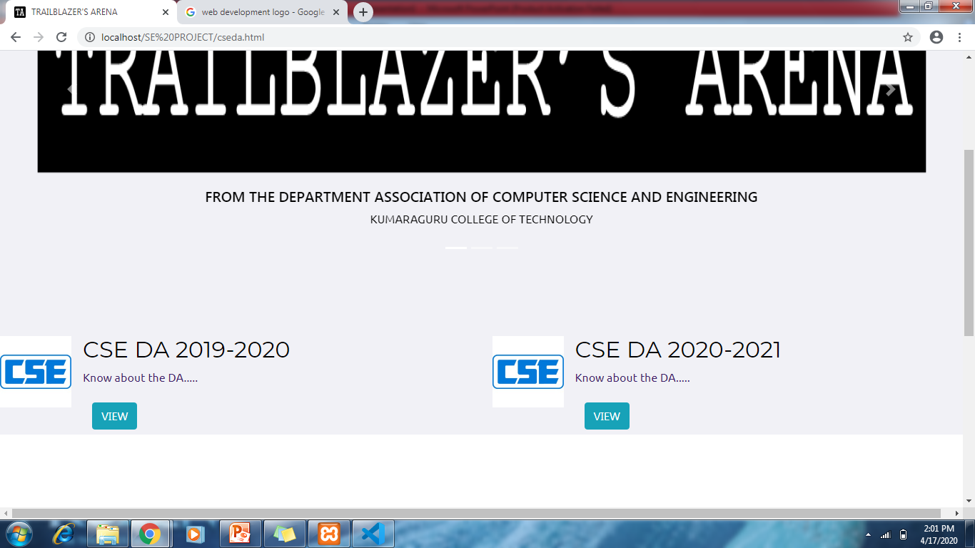
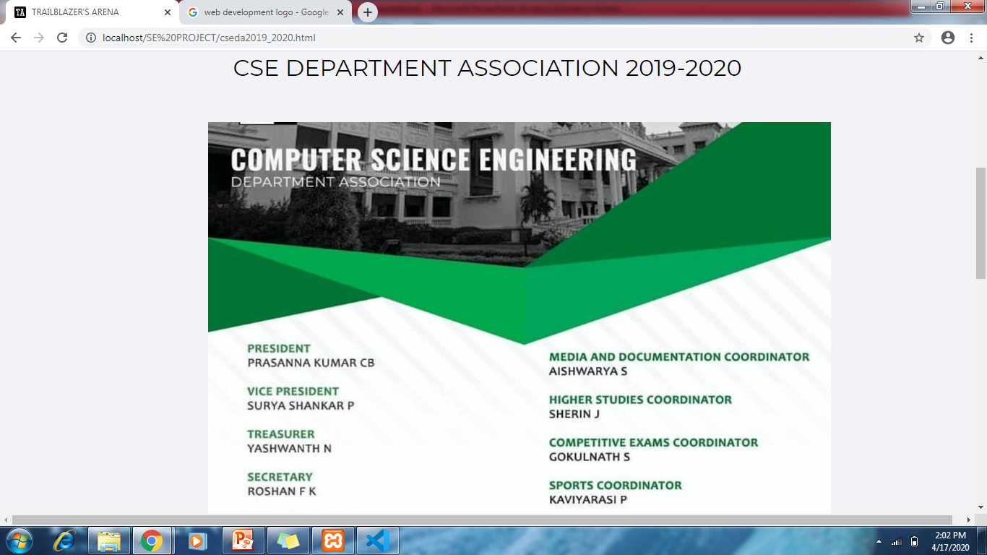
CSE DA page

Slide 29
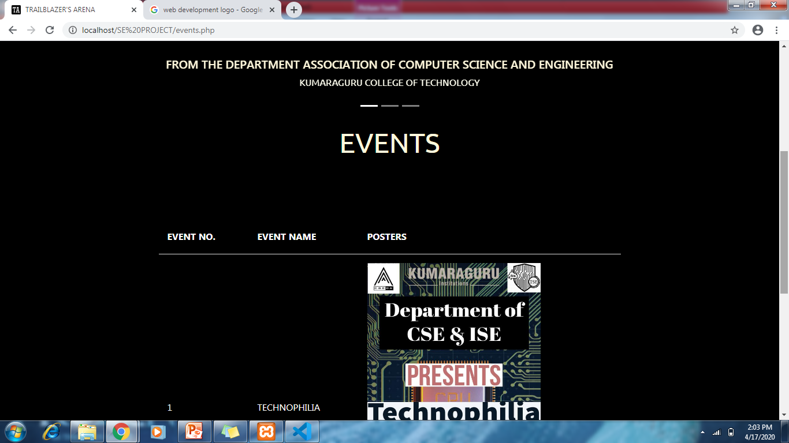
Events page

Slide 30
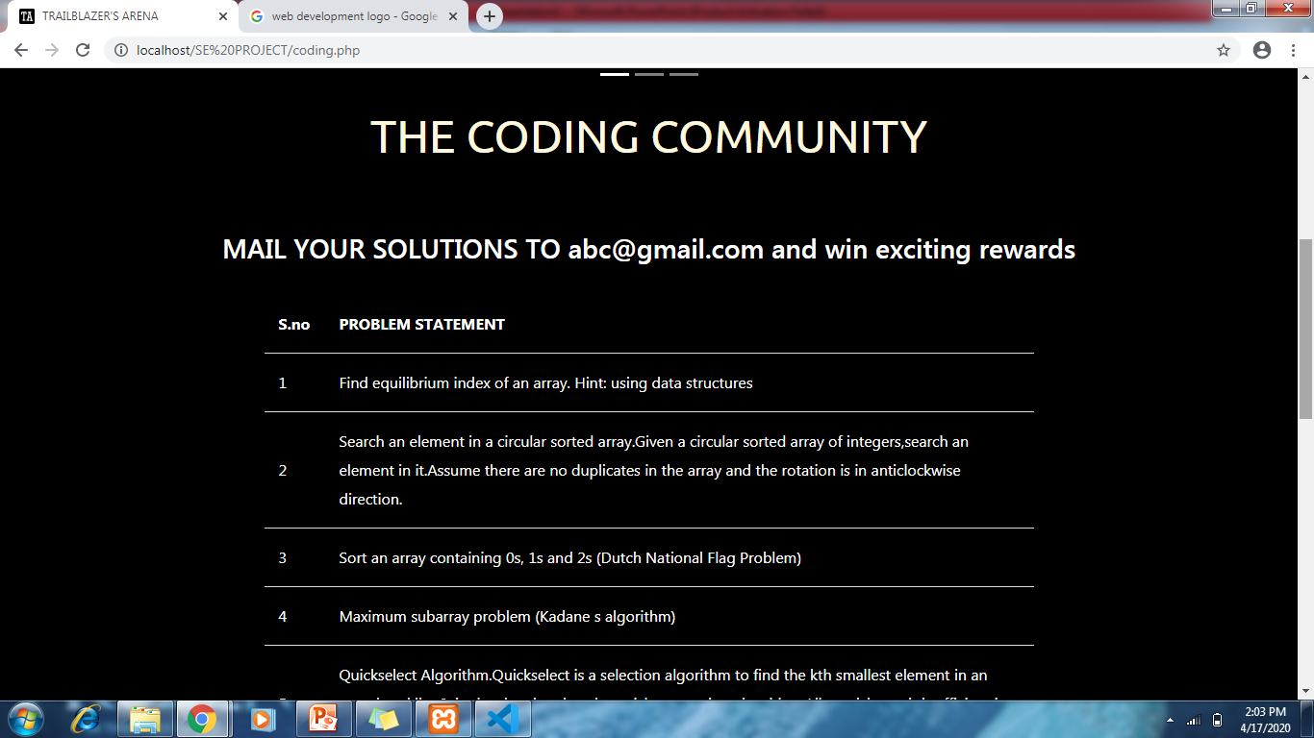
Coding community page

Slide 31
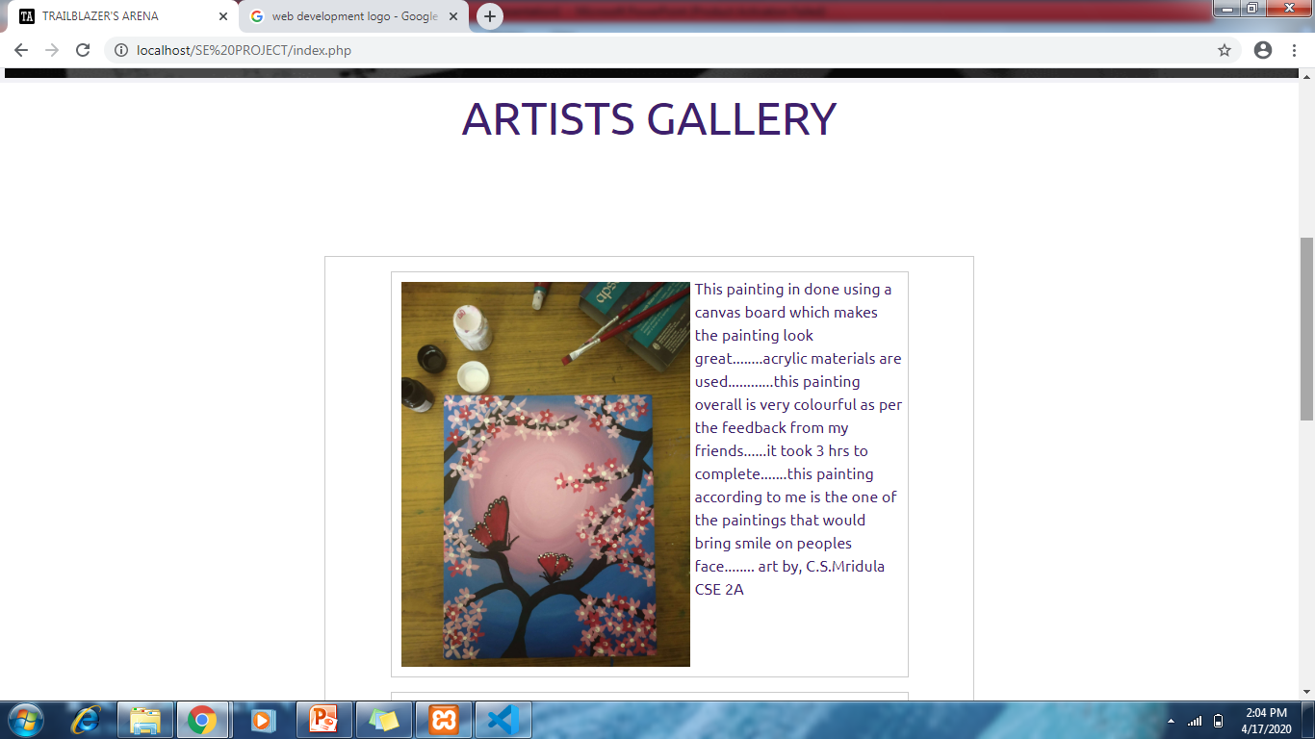
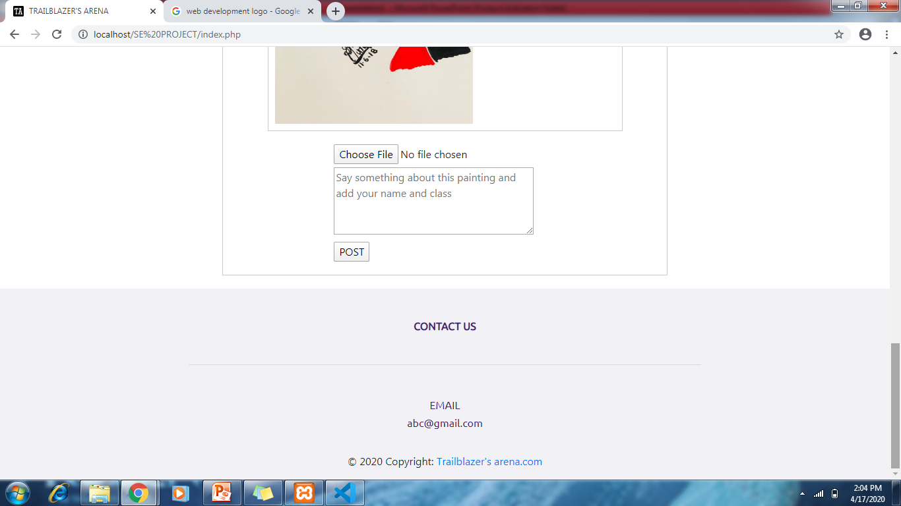
Artists gallery page

Slide 32
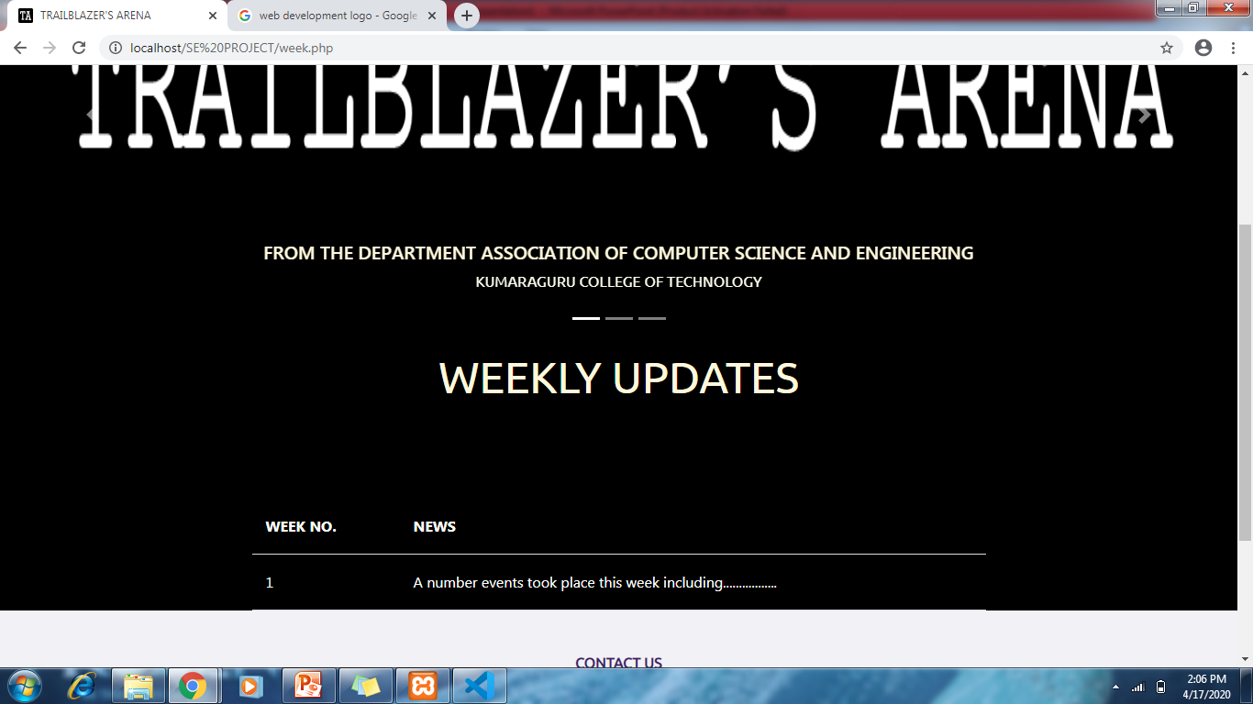
Weekly news page

Slide 33
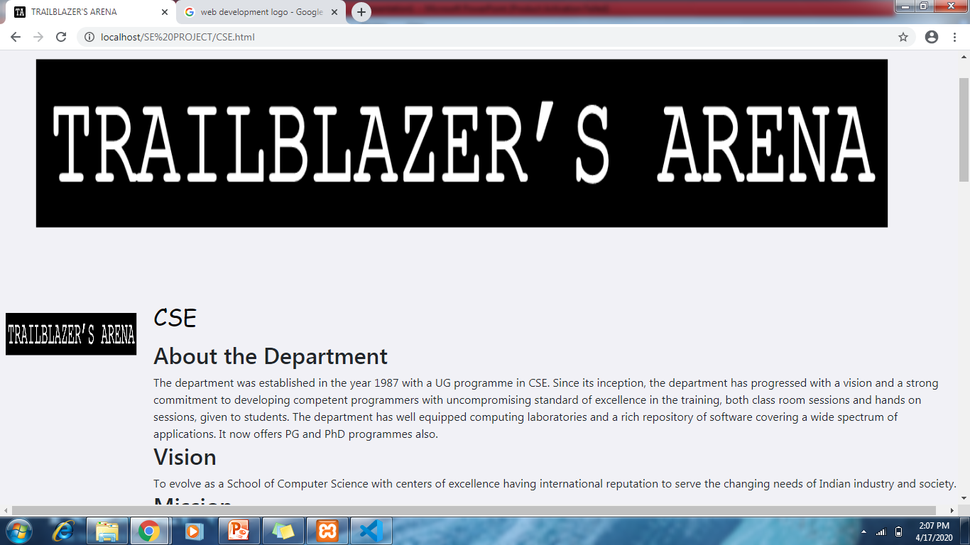
CSE page

Slide 34
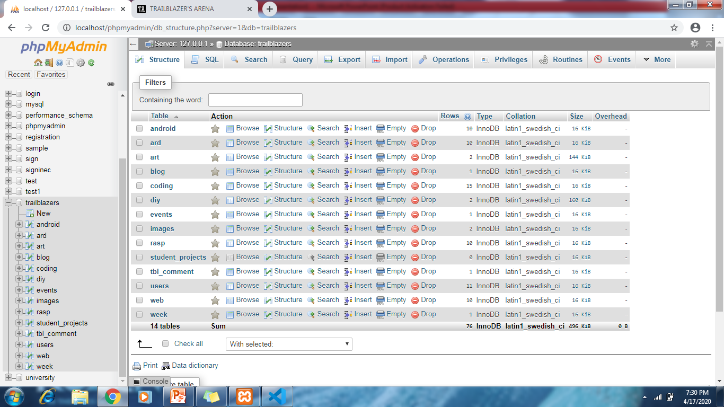
Database tables

Slide 35
THANK YOU

